Slide 1
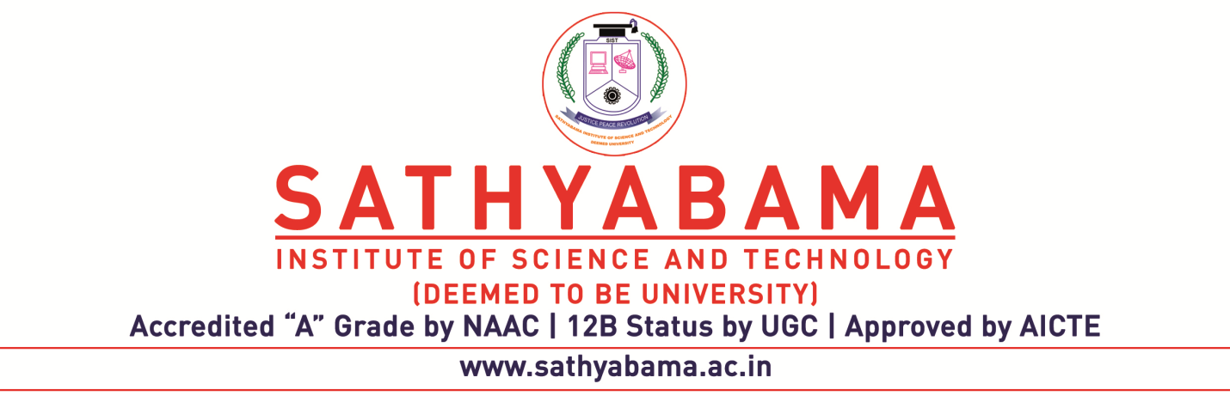
ABALONE AGE PREDICTION USING MACHINE LEARNING
Project Guide :MS.S.Nithya
Name of the Student: D.B.heemashankarrahul
Register Number: 39110286

Slide 2
Presentation Outline
Course Certificate
Introduction
Objectives
Module Implementation
Application Snapshots
Results and Discussions
Conclusion & Future work
References

Slide 3
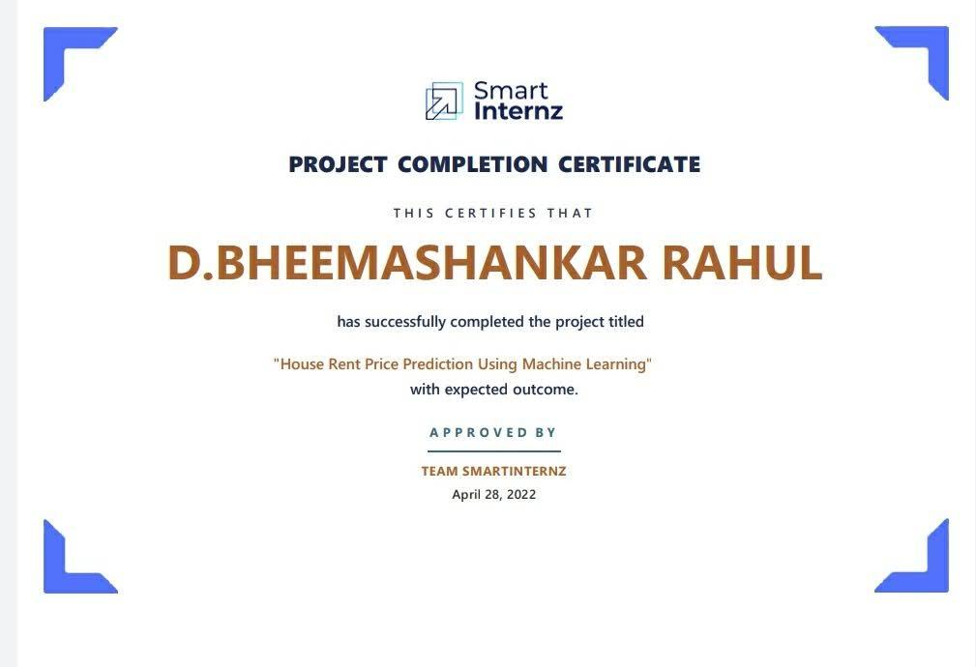
COURSE CERTIFICATE

Slide 4
Introduction
. Chapter 1
Introduction
1.1 Objective
The objective of this project is to predicting the age of abalone from physical measurements using the 1994
abalone data "The Population Biology of Abalone (Haliotis species) in Tasmania. I. Blacklip Abalone (H.
rubra) from the North Coast and Islands of Bass Strait". The data sets were sourced from the UCI Machine
Learning Repository at http://archive.ics.uci.edu/ml/datasets/Abalone
(http://archive.ics.uci.edu/ml/datasets/Abalone). This report is phase 2 of the project, which include model
specification and model selection. Chapter 1 is introduction, chapter 2 is methodology, chapter 3 is data
preparation, chapter 4 is feature selection, chapter 5 is about hyperparameter tuning, chapter 6 is model
comparison, chapter 7 is limitations, chapter 8 presents a brief summar

Slide 5
Problem Statement
Researchers have tried to empoly physical characteristics of abalone such as sex,height,weight,length to determine its age.The correspoinding dataset is found on UCI’S repository.

Slide 6
Objectives
To achieve this goal of this machine learning objective is to visualize the dataset in different formats using python.
Others measurements, which are easier to obtain,are used to predict the age.
The main objective is to determine the age of abalone from the physical measurements.
The economic value of abalone is postively correlted with its age.

Slide 7
Project Implementation
In this project we are going to implement python modules for machine learing.
Matplotlib, Plotly, Pandas, Numpy, Seaborn are the modules which are imported in this project.
Matplotlib : Matplotlib is the most popular python plotting library. It is a low-level library with a Matlab like interface which offers lots of freedom at the cost of having to write more code.
Plotly : It allows users to import, copy and paste, or stream data to be analyzed and visualized.
Pandas : It is an open-source Python Library providing high-performance data manipulation and analysis tool using its powerful data set. Seaborn : It is a phyton using machine learning library based on Matplotlib. It provides a high-level interface for creating attractive graphs.

Slide 8
Hardware requirements:
Computer or pc with latest processor.
Ram: 2gb
Software requirements:
Jupyter Notebook(Anaconda 3)
Python installed in system
Modules installed from python.
To start this project we need a dataset from kaggle or any other dataset providers. Datasets look like .csv files. These datasets contain the information about the data we need.
IN order we to do the Abalone Age Prediction Using Machine Learning.
We have to upload this file in Jupyter after importing the modules.

Slide 9
The analysis in this project shows the results of each and every person of male,femaletheir performances and analyzed the data set by using Abalone Age Prediction Using Machine Learning
After analyzing the dataset the we are going to get the outputs inform of graphs and pie charts.

Slide 10
Methodology
Data Pre-Processing
Data Pre-processing includes the following main tasks
Import the Libraries.
Reading the dataset.
Exploratory Data Analysis
Checking for Null Values.
Data Visualization.
Label Encoding
Splitting the Dataset into Dependent and Independent variables.
Splitting Data into Train and Test

Slide 11
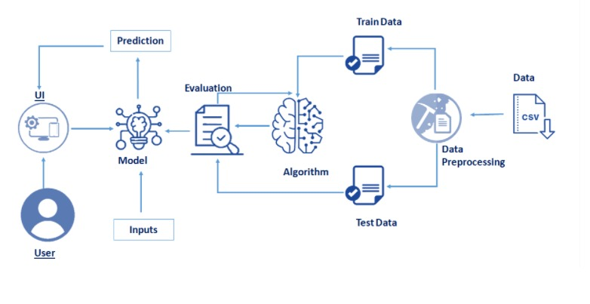
DIAGRAM

Slide 12
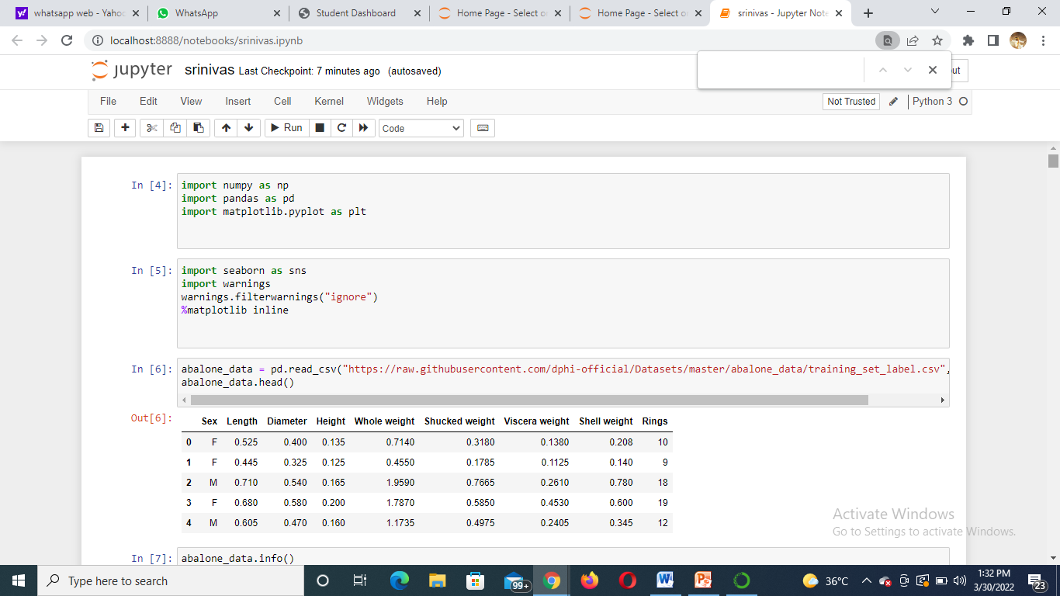
Application Snapshots

Slide 13
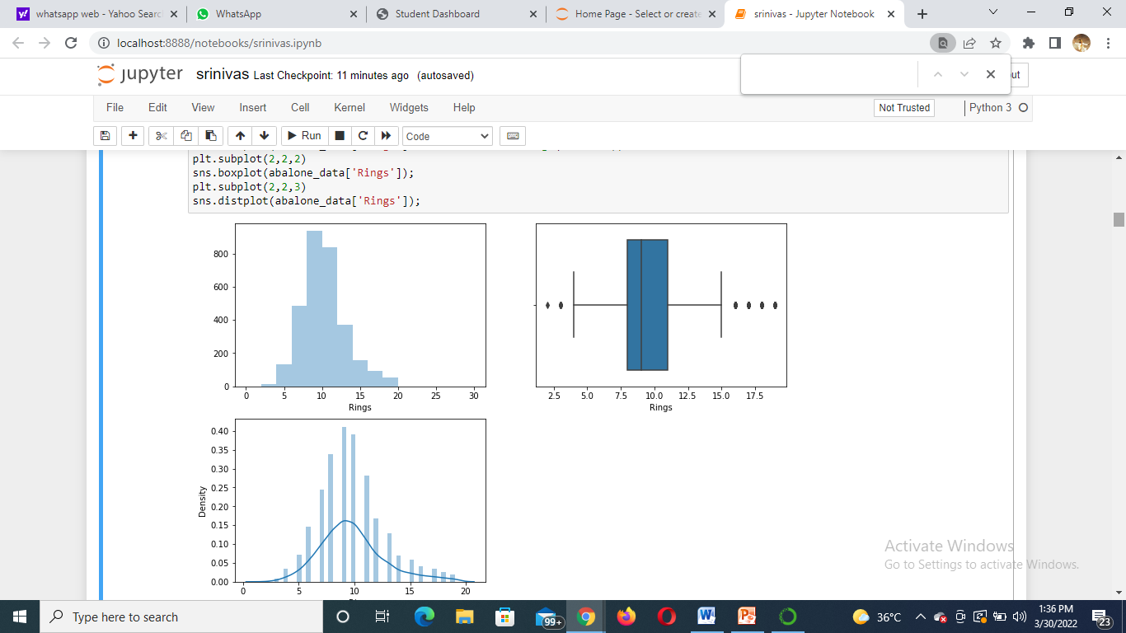
Result
Graph on ground values

Slide 14
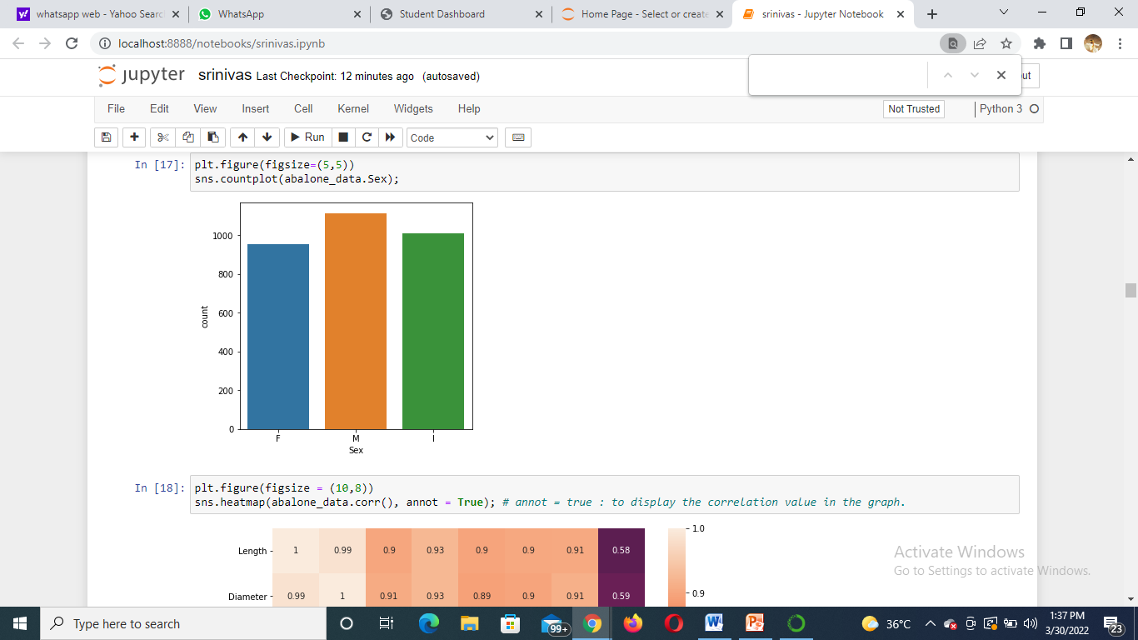
BAR GRAPH

Slide 15
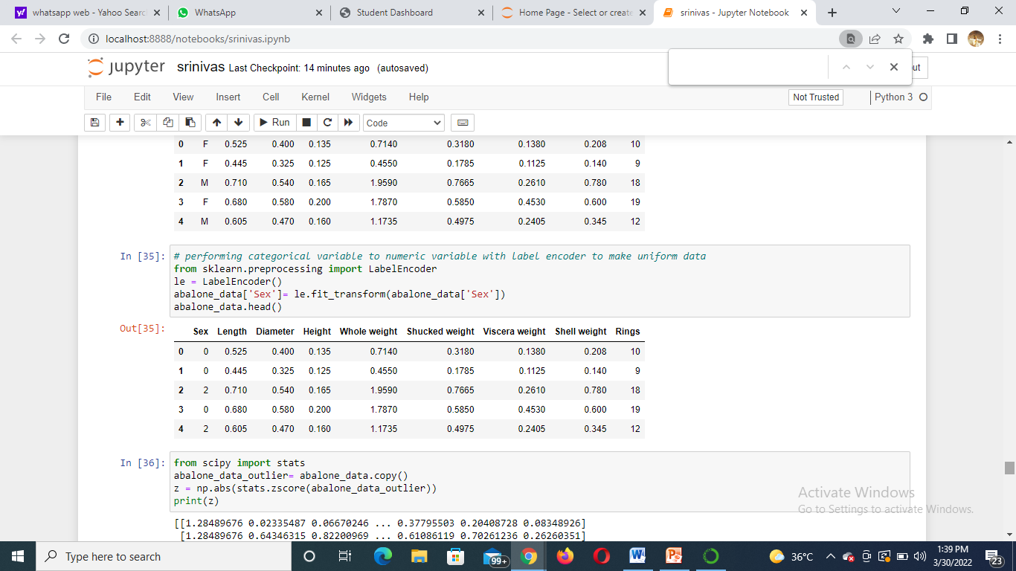
Data frame of all the teams

Slide 16
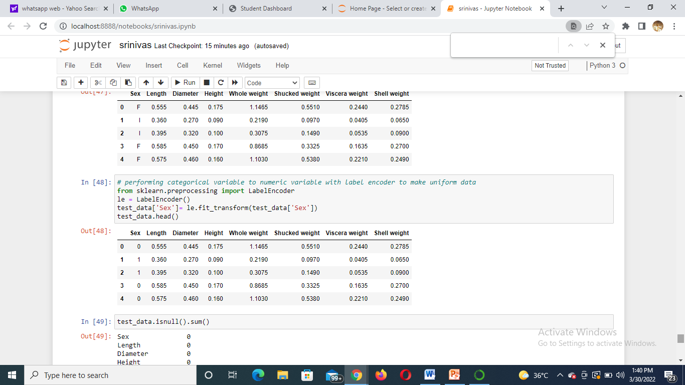
Data frame table on Scores of each team

Slide 17

Conclusion
In this project we can conclude that all the different type of visualizations are shown through Python techniques.
We have illustrated the .csv file which contains the data of Abalone age prediction different forms of graphs and visualizations.
We can use any type of data set and even .tsv files to data visualize the information in the formats we like using Python.

Slide 18
References
[1] Kaggle website for information on data visualizationhttps://www.ijcaonline.org/archives/volume178/number50/mehta-2019-ijca-919425.pdf
[2] The Dataset – GIVEN BY COMPANY
[3] Python 3 for importing packages.

